Slide 1
SS1 Soh Qian Yi (U1922306C), Seat A21
Reviewer: SS1 Samuel Lee Si En, Seat A20

Slide 2







1. Main Page – Level 3
Search…
#03-07
User Guide
1.1 Search
Users can click on ‘Search’ to find direction of specific location.
1.2 Store Information
Users can click on unit buttons (buttons in pink) for more information about the shop.
1.3 Level Selector
Click on level buttons to change level. (Prototype only includes switching between Levels 2 & 3)
#03-06
#03-05
#03-04
#03-03
#02-04
#03-02
#02-10
FILA
JURONG POINT #03-03
CHALLENGER
JURONG POINT #03-01
CONVERSE
JURONG POINT #03-07
NIKE
JURONG POINT #03-02
BALENCIAGA
JURONG POINT #03-04
UNIQLO
JURONG POINT #03-06
CHANEL
JURONG POINT #03-05
#02-03
#03-01
3
#02-02
Tap here to exit..
Tap here to exit..
Tap here to exit..
Tap here to exit..
Tap here to exit..
Tap here to exit..
Tap here to exit..
2
3
2
1
B1
1
B2

Slide 3
2. Search Page
|
User Guide
2.1 Choosing a Location
Users can click on popular locations or manually input their search (prototype only includes navigations to Chanel or Adidas).
2.2 Favourites
Users can click on the heart icon to add the location to their ‘favourites’ or click the heart icon again to ’unfavourite’ a place.
2.3 Back to Main Page
Users can click on greyed out part of the screen to return to main page.
#03-07
POPULAR LOCATIONS NEAR YOU within 150m range
#03-06
CHANEL
JURONG POINT #03-05
#03-05
#03-04
ADIDAS
JURONG POINT #02-03
#03-03
KIDDY PALACE
JURONG POINT #01-03
#02-04
#03-02
#03-01
#02-10
#02-03
STARBUCKS
JURONG POINT #B2-04
3
#02-02
2
3
2
1
B1
1
B2

Slide 4
3.1 Route Overview 2D Page (Same level)
Search…
#03-03
FILA
#03-04
BALENCIAGA
User Guide
3.1.1 Go to Location
Users can click on ‘Go’ button to start navigation.
3.1.2 Back Button
Users can click on the back button to return to main page.
3.1.3 Search
Users can click on search bar to return to search page.
#03-05
CHANEL
#03-02
NIKE
#03-01
CHALLENGER
#03-06
UNIQLO
G O
3
2
3
1
B1
CHANEL
B2
JURONG POINT #03-05
1min, 1m

Slide 5
4.1 Navigation 3D Page (Same level)
#03-03
FILA
#03-05
CHANEL
#03-02
NIKE
#03-06
UNIQLO
User Guide
4.1.1 Back Button
Users can click on the back button to return to previous page (Route Overview 2D Page).
#03-01
CHALLENGER
3
2
3
1
B1
CHANEL
1m
B2
JURONG POINT #03-05
1min, 1m

Slide 6
4.1 Navigation 3D Page (Same level)
Search…
User Guide
4.1.1 Back Button
Users can click on the back button to return to previous page (Route Overview 2D Page).
4.1.2 Search
Users can click on search bar to return to search page.
4.1.3 Click to Main Page
Users can click on grey box after arriving at destination to return to main page.
#03-03
FILA
#03-05
CHANEL
YOU HAVE ARRIVED AT YOUR DESTINATION!
-Click to Main Page-
3
2
3
1
B1
CHANEL
B2
JURONG POINT #03-05

Slide 7
5. Mode Page
Search…
#03-03
FILA
#03-04
BALENCIAGA
User Guide
5.1 Select a Mode
Users can select a mode -- stairs/escalator/lift/ramp (Prototype only includes ‘Escalator’ mode (2nd button from the left))
5.2 Back Button
Users can click on the back button to return to main page.
5.3 Search
Users can click on search bar to return to search page.
#03-02
NIKE
#03-05
CHANEL
#03-01
CHALLENGER
#03-06
UNIQLO
MODE:
S
E
L
R
3
2
3
1
B1
ADIDAS
B2
JURONG POINT #02-03
2min, 2m

Slide 8
3.2 Route Overview 2D Page (Different level)
Search…
#03-03
FILA
#03-04
BALENCIAGA
E
#03-02
NIKE
#03-05
CHANEL
User Guide
3.2.1 Back Button
Users can click on the back button to return to previous Mode page.
3.2.2 Search
Users can click on search bar to return to search page.
#03-01
CHALLENGER
#03-06
UNIQLO
3
2
3
1
B1
ADIDAS
B2
JURONG POINT #02-03
2min, 2m

Slide 9
3.2 Route Overview 2D Page (Different level)
#02-03
ADIDAS
Search…
#02-05
KFC
User Guide
3.2.1 Go to Location
Users can click on ‘Go’ button to start navigation.
3.2.2 Back Button
Users can click on the back button to return to previous page.
3.2.2 Search
Users can click on search bar to return to search page.
#02-06
BEN & JERRY’S
#02-02
H&M
G O
#02-07
COFFEE BEAN
#02-01
FOREVER21
3
2
2
1
B1
ADIDAS
B2
JURONG POINT #02-03
2min, 2m

Slide 10
4.2 Navigation 3D Page (Different level)
#03-03
FILA
#03-05
CHANEL
E
#03-02
NIKE
#03-06
UNIQLO
User Guide
4.2.1 Back Button
Users can click on the back button to return to previous page (Route Overview 2D Page).
#03-01
CHALLENGER
3
2
3
1
E
B1
ADIDAS
1m
B2
JURONG POINT #02-03
2min, 2m

Slide 11
4.2 Navigation 3D Page (Different level)
#02-05
KFC
#02-03
ADIDAS
#02-06
BEN & JERRY’s
#02-02
H&M
User Guide
4.2.1 Back Button
Users can click on the back button to return to previous page (Route Overview 2D Page).
#02-07
COFFEE BEAN
3
2
2
1
B1
ADIDAS
1m
B2
JURONG POINT #02-03
2min, 2m

Slide 12
4.2 Navigation 3D Page (Different level)
Search…
User Guide
4.2.1 Back Button
Users can click on the back button to return to previous page (Route Overview 2D Page).
4.2.2 Search
Users can click on search bar to return to search page.
4.2.3 Click to Main Page
Users can click on grey box after arriving at destination to return to main page.
#02-05
KFC
#03-03
ADIDAS
YOU HAVE ARRIVED AT YOUR DESTINATION!
-Click to Main Page-
3
2
2
1
B1
ADIDAS
B2
JURONG POINT #02-03

Slide 13
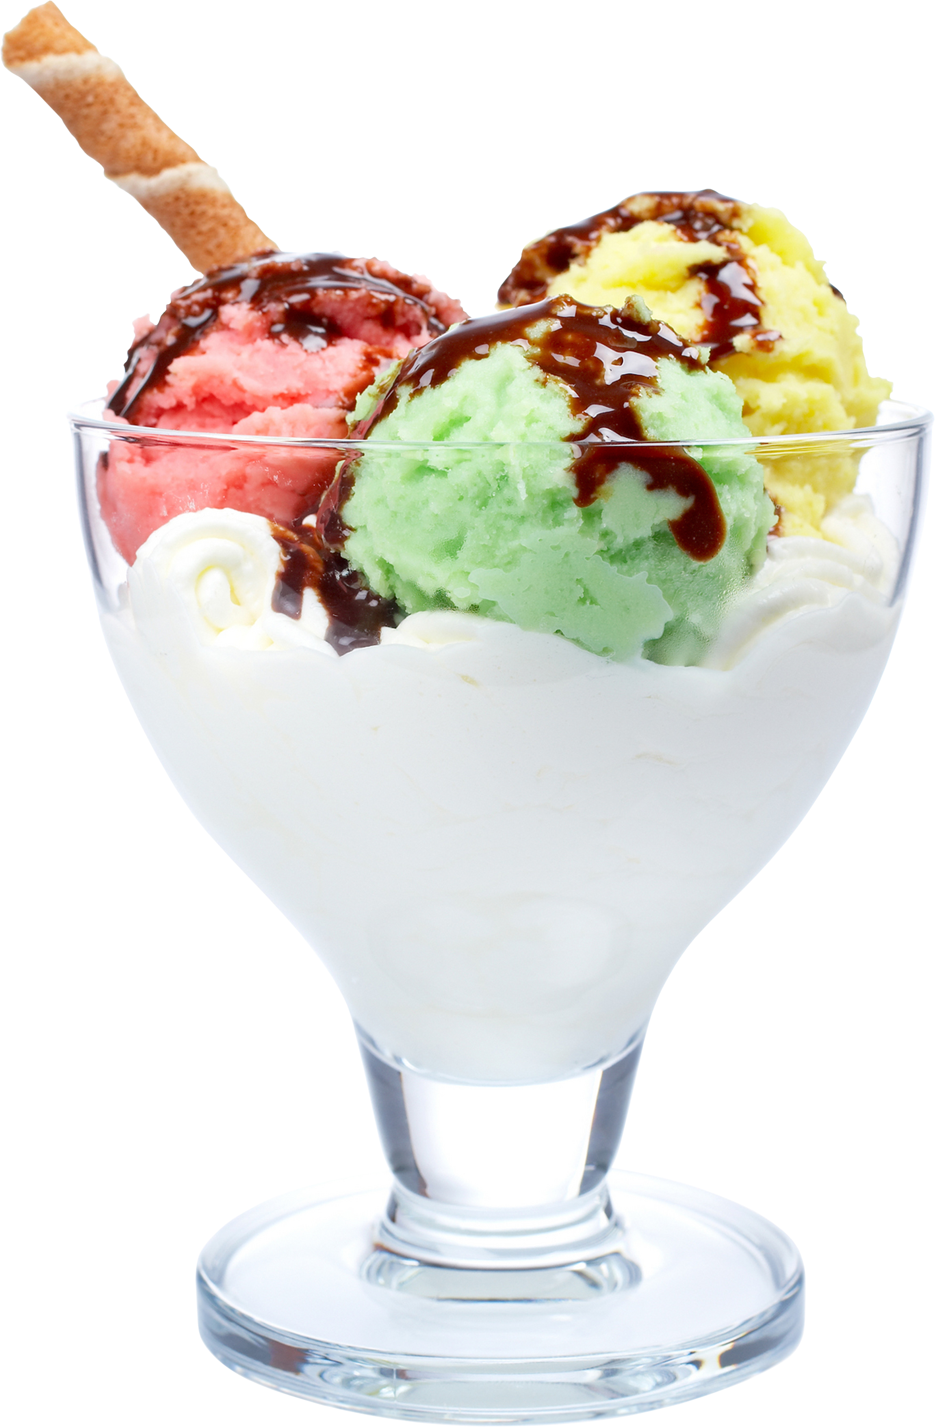






1. Main Page – Level 2
Search…
#02-07
User Guide
1.1 Search
Users can click on ‘Search’ to find direction of specific location.
1.2 Store Information
Users can click on unit buttons (buttons in pink) for more information about the shop.
1.3 Level Selector
Click on level buttons to change level. (Prototype only includes switching between Levels 2 & 3)
#02-06
#02-05
#02-04
#02-03
#01-04
#02-02
#01-10
ADIDAS
JURONG POINT #02-03
COFFEE BEAN
JURONG POINT #02-07
MCDONALD’S
JURONG POINT #02-04
H&M
JURONG POINT #02-02
FOREVER21
JURONG POINT #02-01
KFC
JURONG POINT #02-05
BEN & JERRY’S
JURONG POINT #02-06
#01-03
#02-01
2
#01-02
Tap here to exit..
Tap here to exit..
Tap here to exit..
Tap here to exit..
Tap here to exit..
Tap here to exit..
Tap here to exit..
1
3
2
1
B1
B1
B2

